Slide 1
GDS Import Wizard CSV input Demo
Yongsheng.guo@ansys.com
2022-01-17

Slide 2
CSV Format
NO | LayerName | Type | LayerMap | TextLayerMap | Thickness | Height | LowerLayer | UpperLayer | DK | DF | Cond | TC1 | TC2
1 | TOP_UBM | C | 214;0 | 214;0 | 44.5 |  |  |  | 4 | 0.02 | 5.80E+07
2 | PI1 | V | 11;0 |  | 3 |  |  |  | 4 | 0.02 | 5.80E+07
3 | RDL1 | C | 1;0 |  | 4 |  |  |  | 4 | 0.02 | 5.80E+07
4 | PI2 | V | 12;0 |  | 3 |  |  |  | 4 | 0.02 | 5.80E+07
5 | RDL2 | C | 2;0 |  | 4 |  |  |  | 4 | 0.02 | 5.80E+07
6 | PI3 | V | 13;0 |  | 3 |  |  |  | 4 | 0.02 | 5.80E+07
7 | RDL3 | C | 3;0 |  | 4 |  |  |  | 4 | 0.02 | 5.80E+07
8 | PI4 | V | 14;0 |  | 3 |  |  |  | 4 | 0.02 | 5.80E+07
9 | RDL4 | C | 4;0 |  | 4 |  |  |  | 4 | 0.02 | 5.80E+07
10 | PI5 | V | 15;0 |  | 3 |  |  |  | 4 | 0.02 | 5.80E+07
11 | BOT_UBM | C | 215;0 | 215;0 | 58 |  |  |  | 4 | 0.02 | 5.80E+07
CSVInput_demo.csv
The highlighted column must be given.
Type: “C” indicate conductor, “V” indicate Via.
TextLayerMap used to trace nets information.
The default unit is um.
If setting DK/DF/Cond, accurate material will add to stackup

Slide 3
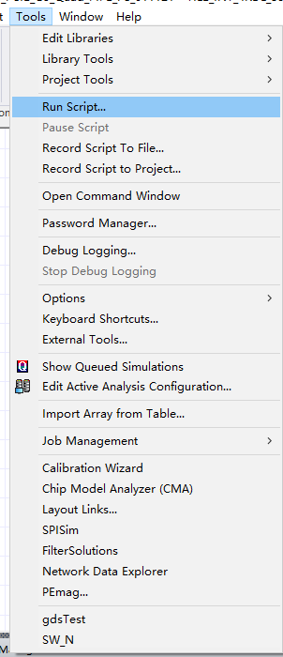
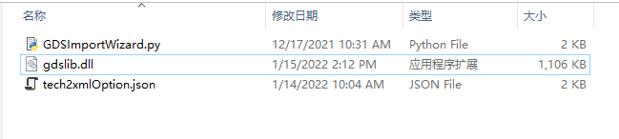
Step1 run GDSImportWizard.py

Slide 4
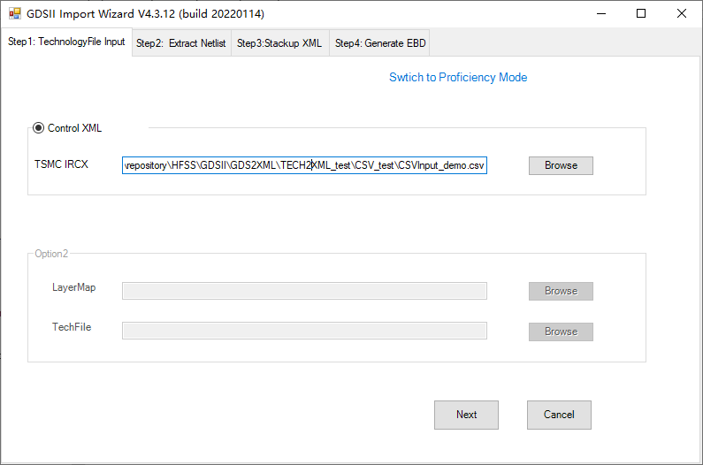
Step2
Click switch mode
Select CSV file

Slide 5
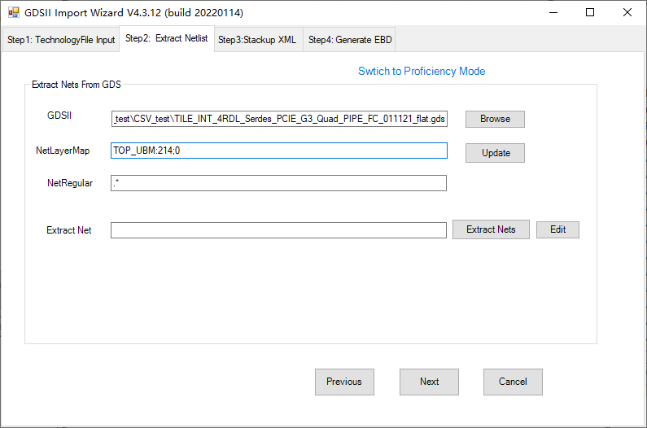
step3
选择GDS，单击update

Slide 6
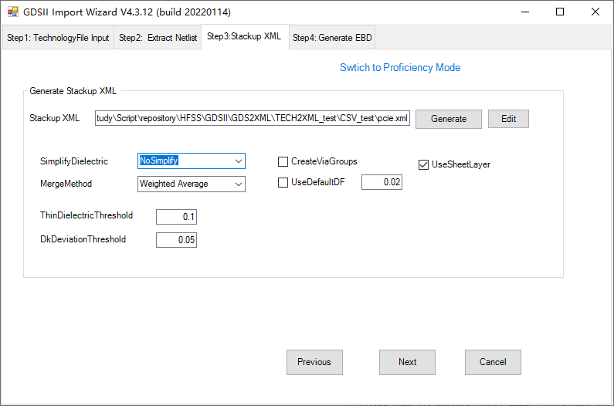
step4
“No Simplify”
Not check “CreateViaGroups”
Click Generate

Slide 7
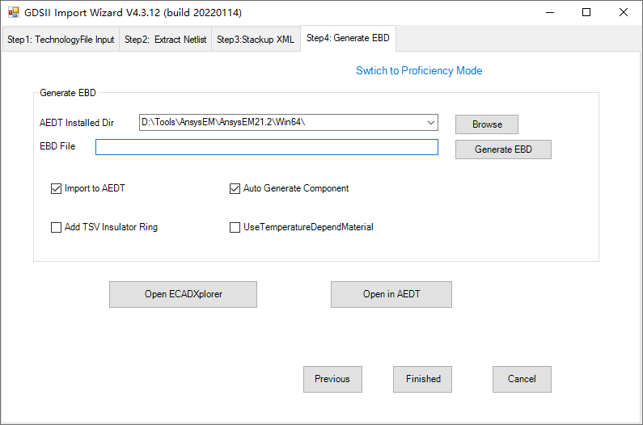
step5
Check“Import to AEDT”
check “Auto Generate Component”
Click Generate EDB

Slide 8
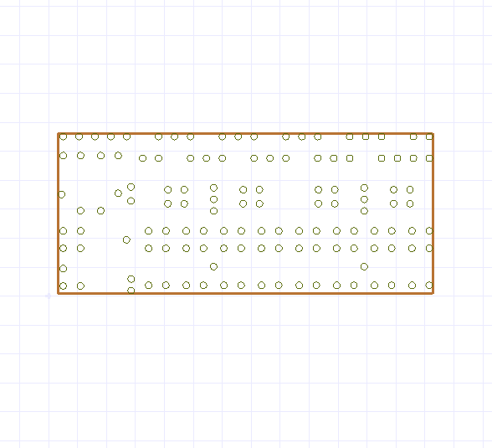
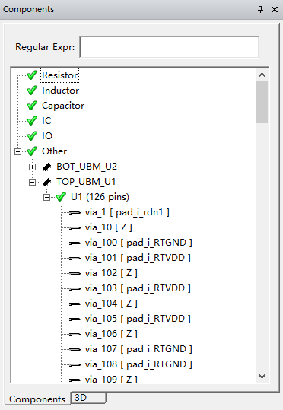
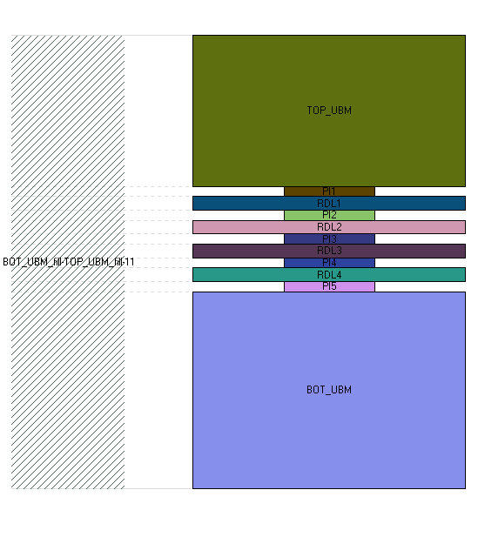
Final
Components
Stackup

